Slide 1
Welcome
TO
“KidSmile Teddy”

Slide 2

Dear Customer/Dealer,
We are happy to render the service with our toys for various events organized by you.
Toys bring joy and happiness in whichever environment they were assembled.
We are trying to make your events little more energetic and grand with our smart toys.

Slide 3
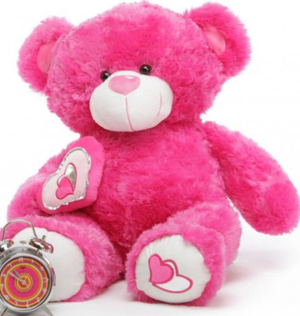
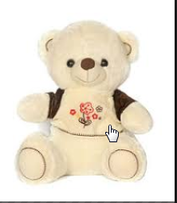
Name: White Teddy002
Size : 30CM,60Cm
Color: white
Name: Teddy001
Size : 75CM
Color : Pink, Blue Brown

Slide 4
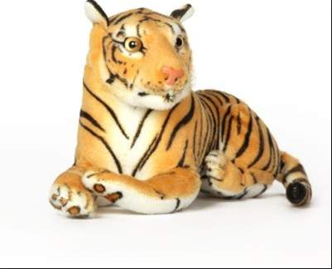
Name : Tiger 003
Size : 32Cm,64CM,108CM,120Cm
Color: Brown

Slide 5
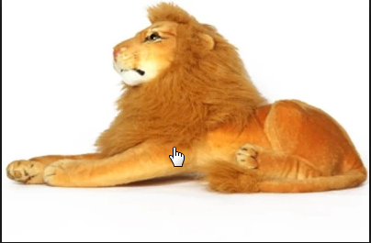
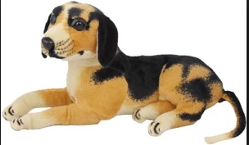
Name : Lion 004
Size : 32cm,64cm
Color : Brown
Name : Dog 005
Size : 32CM,64cm,108CM
Color: black and brown

Slide 6
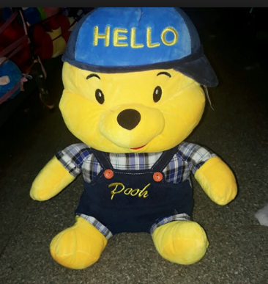
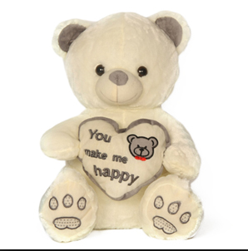
Name : Pooh 006
Size : 30CM,60Cm
Name : White Heart Teddy 007
Size: 30Cm,60CM

Slide 7
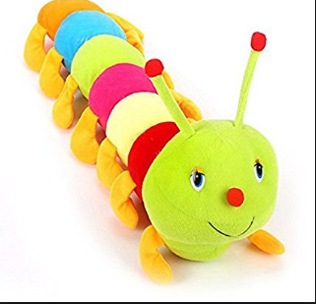
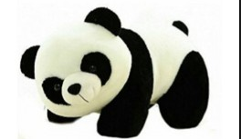
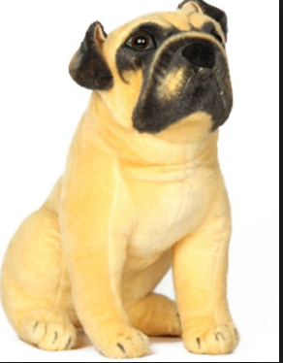
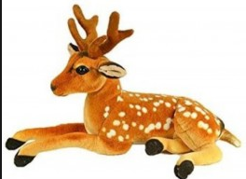
Name : Panda 009
Size : 30Cm,60cm
Name : Caterpillar 008
Size : 100Cm
Name: Hutch dog 011
Size : 32cm,64cm
Name : Deer 010
Size : 25Cm,64Cm

Slide 8
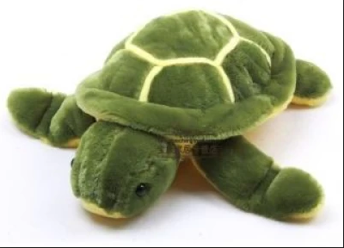
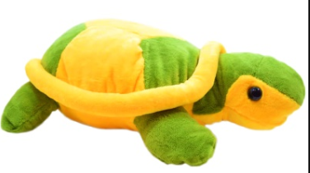
Name : Tortoise 012
Size : 35Cm
Color : Green
Name : Tortoise 013
Size : 35Cm
Color : Green and yellow

Slide 9
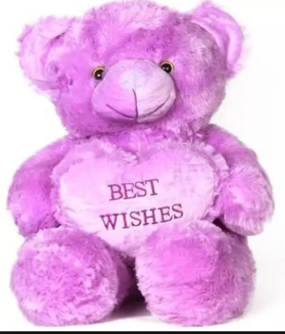
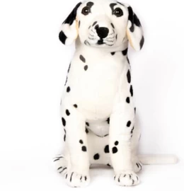
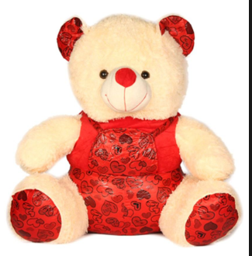
Name : M.Teddy 014
Size : 32CM,75CM
Color: Blue, Pink, Brown, Red
Name : White Dog 015
Size : 30Cm
Name : Pretty Teddy 016
Size : 30Cm, 60CM

Slide 10
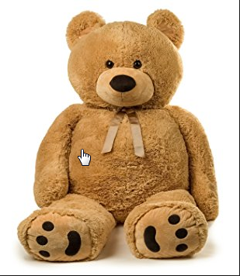
Name : Jumbo Teddy 017
Size : 4.5 feet,5.5 Feet
Color : Brown,Blue, Red,Pink

Slide 11
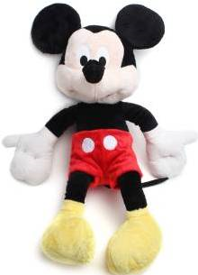
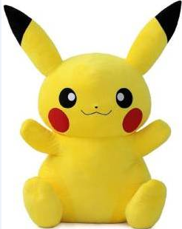

Name : Mickey 018
Size : 30Cm,60Cm
Name : Pikachu 019
Size : 30Cm,60Cm
Name : Red Heart 020
Size : 30Cm,60Cm

Slide 12
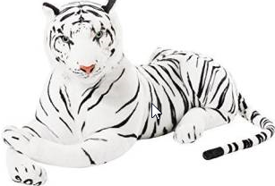
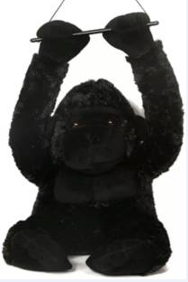
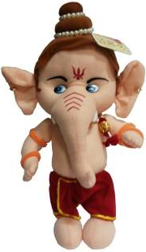
Name : white Tiger021 Size : 108CM
Name : Ganesh 023
Size :35CM
Name :Gorilla 022
Size : 50CM

Slide 13
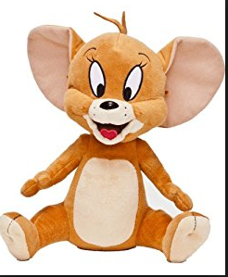
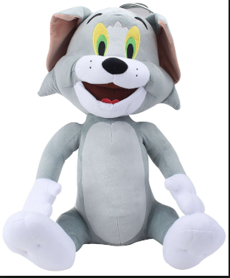
Tom AND Jerry
Name : Jerry 024
Size : 8 inches
Name : Tom 025
Size : 8 inches

Slide 14
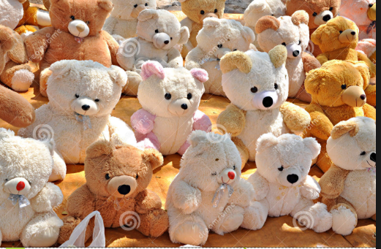
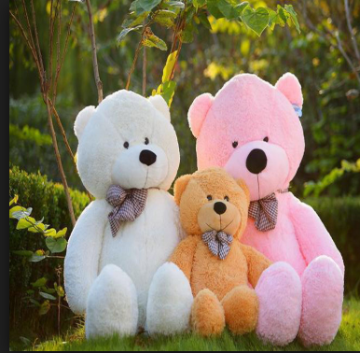
Name : Family Teddy

Slide 15
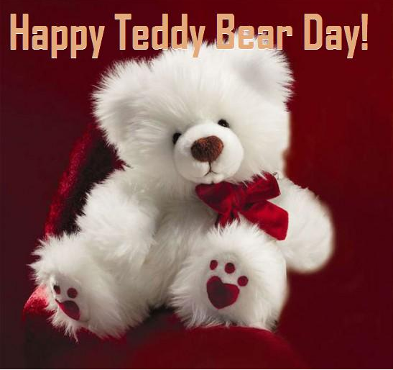

Slide 16
Thank You

